Slide 1
Greek and Roman gods

Slide 2
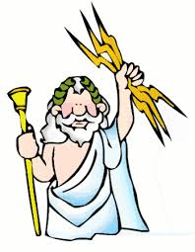
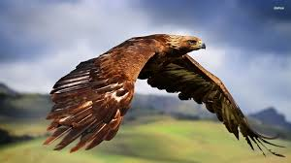
Olympian gods
Greek name Zeus
Roman name: Jupiter
Rules over: kings, judges,
is king of gods
Symbols: Eagle, lightening, bull, oak

Slide 3
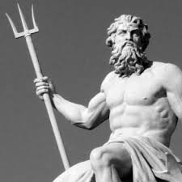
Olympian gods
Greek name: Poseidon
Roman name: Neptune
Rules over: Sea
Symbols: Trident, Horse,
Dolphin

Slide 4
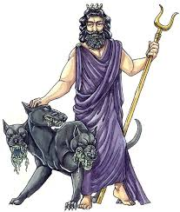
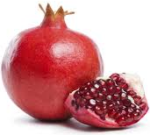
Olympian gods
Greek name: Hades
Roman name: Pluto
Rules over: riches, afterlife
Symbols: Pomegranate

Slide 5
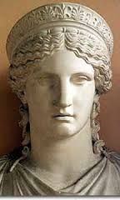
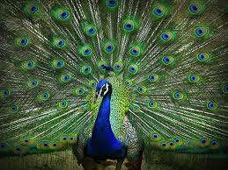
Olympian gods
Greek name: Hera
Roman name: Juno
Rules over: Marriage,
is queen of gods
Symbols: peacock, cow

Slide 6
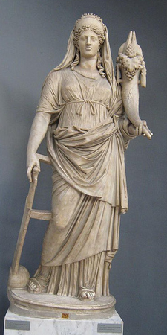
Olympian gods
Greek name: Demeter
Roman name: Ceres
Rules over: Agriculture
(farms)
Symbols: grain,
horn of plenty

Slide 7
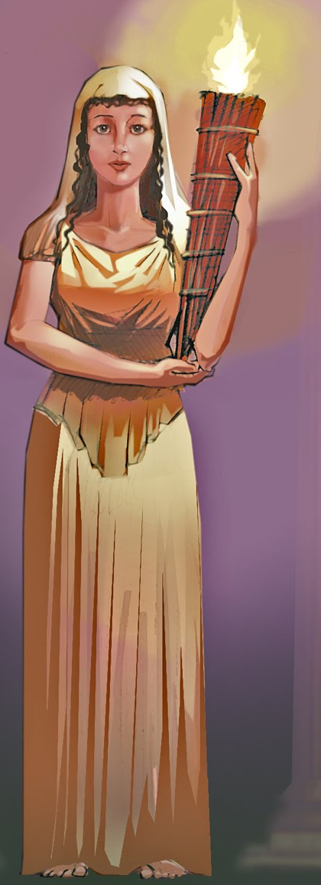
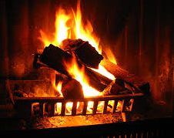
Olympian gods
Greek name: Hestia
Roman name: Vesta
Rules over: home, hearth
Symbols: hearth

Slide 8
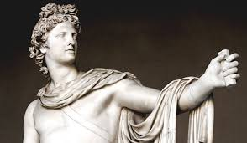
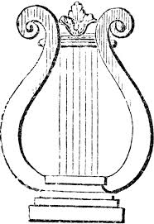
Olympian gods
Greek name: Apollo
Roman name: Apollo
Rules over: Prophesy
Music
Symbols: Lyre, sun,
bow

Slide 9
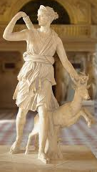
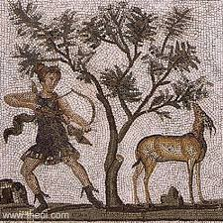
Olympian gods
Greek name: Artemis
Roman name: Diana
Rules over: Hunting, birth,
young girls
Symbols: Moon, bow,
cypress tree,
stag

Slide 10
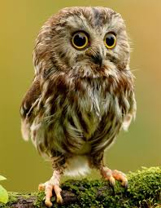
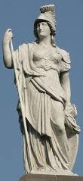
Olympian gods
Greek name: Athena
Roman name: Minerva
Rules over: wisdom, weaving,
plans in war
Symbols: Owl, loom,
olive tree

Slide 11
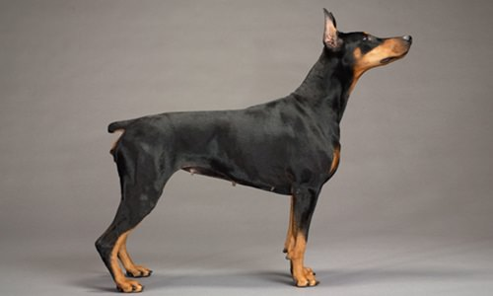
Olympian gods
Greek name: Ares
Roman name: Mars
Rules over: strength in war
Symbols: spear, dog

Slide 12
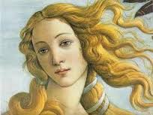
Olympian gods
Greek name: Aphrodite
Roman name: Venus
Rules over: Love, beauty
Symbols: dove, rose

Slide 13
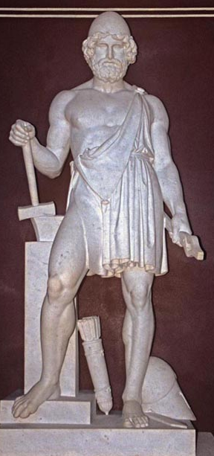
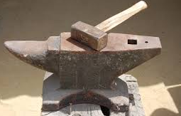
Olympian gods
Greek name: Hephaestus
Roman name: Vulcan
Rules over: fire, forge
Symbols: Hammer

Slide 14
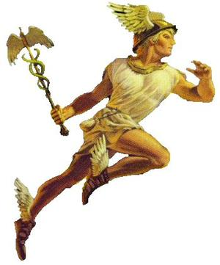
Olympian gods
Greek name: Hermes
Roman name: Mercury
Rules over: messengers, thieves
Symbols: Caduceus, winged sandals

Slide 15
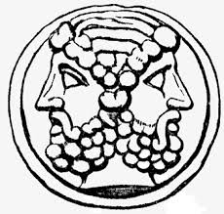
Minor Roman god
Roman name Janus
Rules over thresholds, beginnings, endings
Shown looking forward and backward

Slide 16
Minor Roman god
Greek name Hygieia
Roman name Hygea
Rules over: sanitation, good health, hygiene

